Slide 1

Secure Personal Cloud Storage System using AWS
"A smart alternative to Google Drive with AWS-powered architecture."
Made By :
Gopesh Sharma

Slide 2




Project Overview: Your Personal Cloud
Scalable Storage
EC2 Web Interface
Upload, manage, and access personal files from anywhere.
Simple web interface hosted on an EC2 instance for user interaction.
S3 File Storage
Enhanced Security
Robust and durable file storage leveraging Amazon S3.
User authentication via IAM/Cognito and file encryption ensures data privacy.
This project demonstrates a real-world cloud-native architecture, providing a mini Google Drive-like solution with full user control.
Made By :
Gopesh Sharma

Slide 3
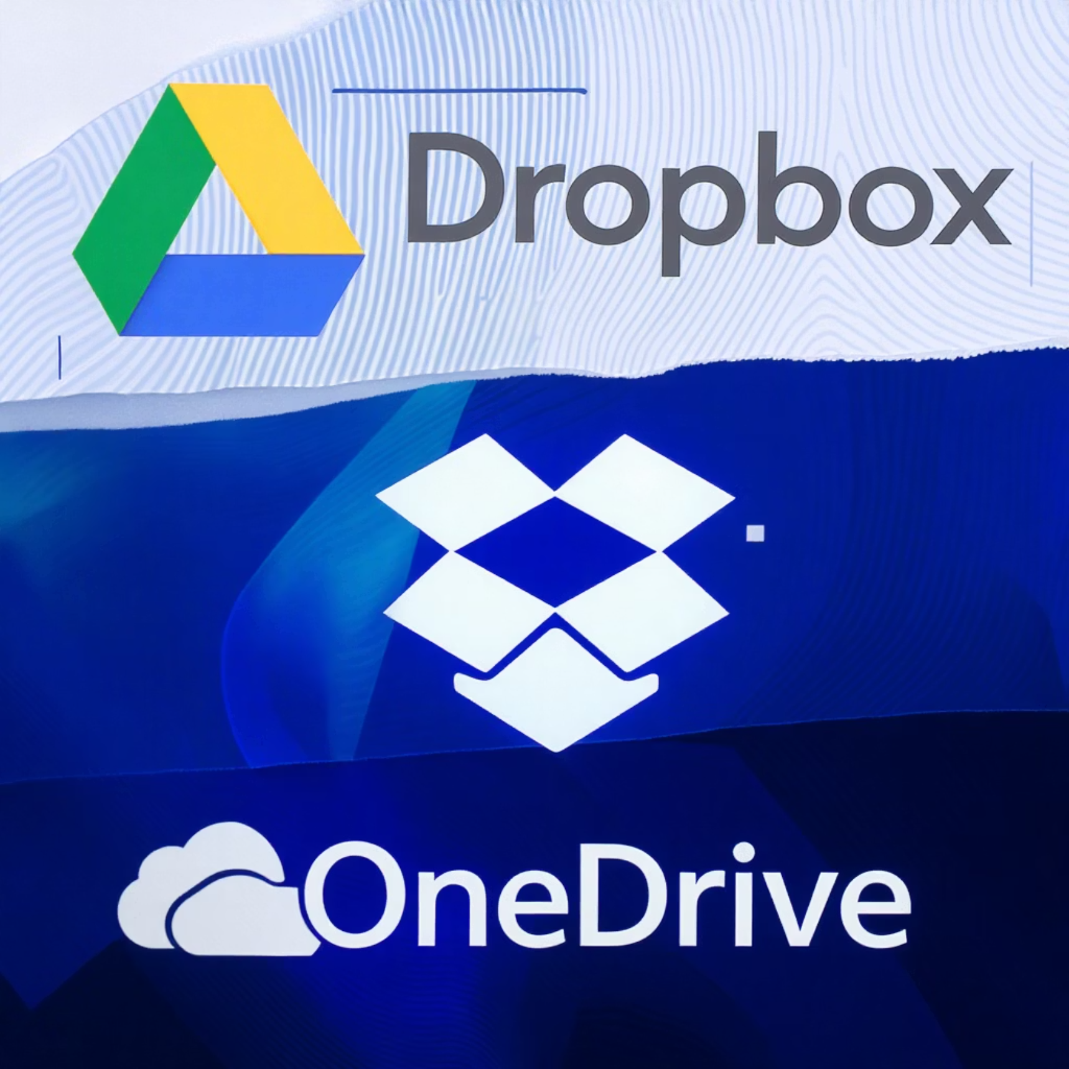
Understanding Existing Cloud Solutions
Current Solutions
Google Drive, Dropbox, OneDrive offer centralized storage.
They provide basic cloud file storage and syncing capabilities.
Key Drawbacks
Privacy concerns due to third-party data control.
Limited customization options and infrastructure control.
Often require premium costs for advanced features and larger
storage.
Closed-source backend limits transparency and innovation.
Made By :
Gopesh Sharma

Slide 4




The Proposed System: A User-Owned Cloud
Personal Control
Custom UI
Users host their own cloud storage, maintaining full control over access, storage, and encryption.
Files can be uploaded, organized, and retrieved via a tailored web interface hosted on EC2.
Integrated Security
Performance Monitoring
IAM/Cognito handles secure authentication and precise permissions for users.
CloudWatch tracks system health and performance, ensuring reliable operation.
This modular system offers high security, scalability, and significant educational value in mastering AWS services.
Made By :
Gopesh Sharma

Slide 5

LITERATURE SURVEY
YEAR | AUTHOR | TITLE | ALGORITHM/TECH | MERITS | DEMERITS
2026 | Riya Thomas | Scalable Cloud File System Using AWS Lambda & S3 | Serverless Architecture | Low cost and high scalability | Cold start delays
2025 | Gopesh Sharma (You) | Secure Personal Cloud Storage Using AWS EC2 and S3 | EC2, S3, IAM, Cognito, CloudWatch | Full control, modular, secure, educational | Requires AWS knowledge and cost planning
2025 | Alex Dsouza | IAM-Based Authentication in Cloud File Sharing | AWS IAM Policies | Fine-grained access control | Complex to configure for large-scale apps
2024 | Nishita Roy | Encrypted Personal Storage with S3 and KMS | AWS KMS, S3 Server-Side Encryption | Strong encryption and data integrity | KMS key management overhead
2023 | AWS Whitepaper (Official) | Cloud Storage Architectures on AWS | EC2, S3 | Proven durability and availability (99.999999999%) | Vendor lock-in, requires AWS service integration
Made By :
Gopesh Sharma

Slide 6

Thank You
Made By :
Gopesh Sharma

